Slide 1
DATA STRUCTURES
QUEUES

Slide 2
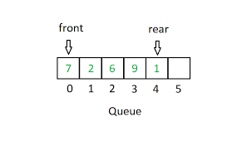
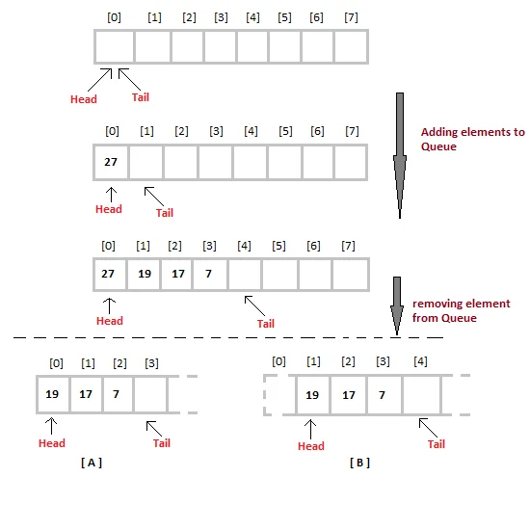
What Is A Queue?
A queue is an important data structure in programming. A queue follows the FIFO (First In First Out) method and is open at both of its ends. Data insertion is done at one end rear end or the tail of the queue while deletion is done at the other end called the front end or the head of the queue.

Slide 3
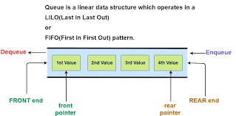
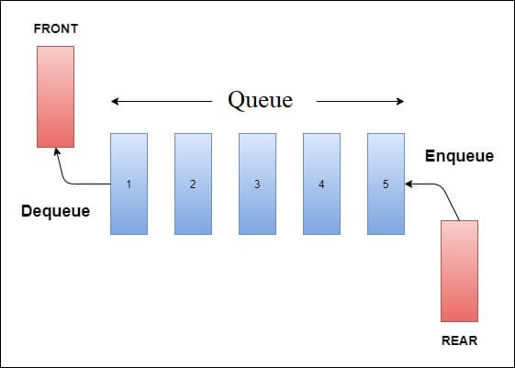
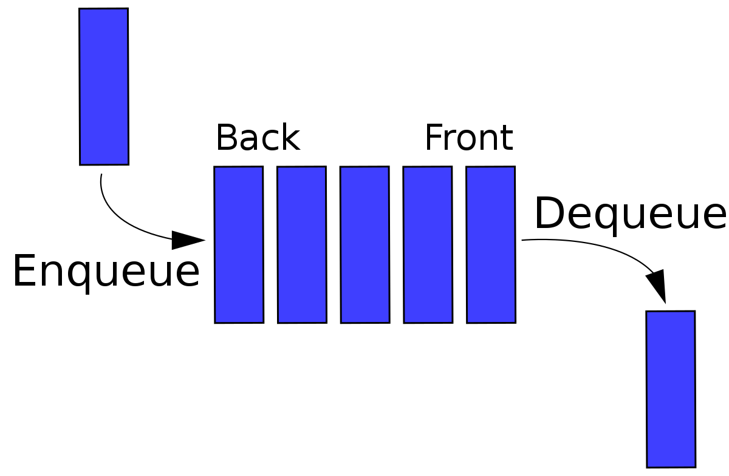
Queue

Slide 4
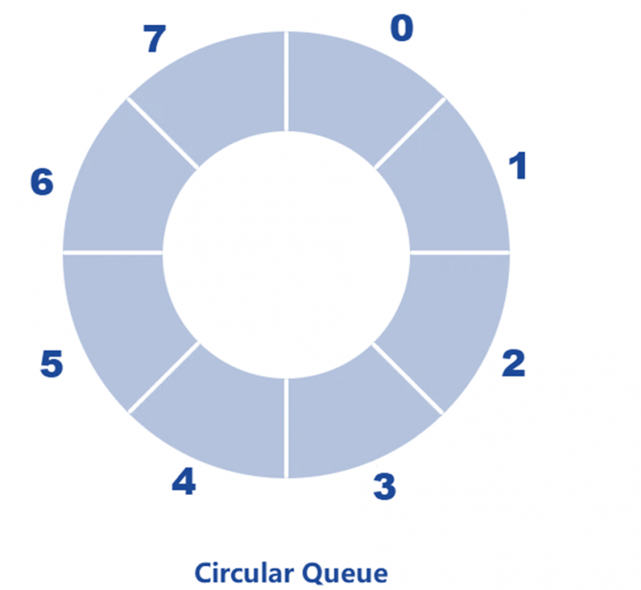
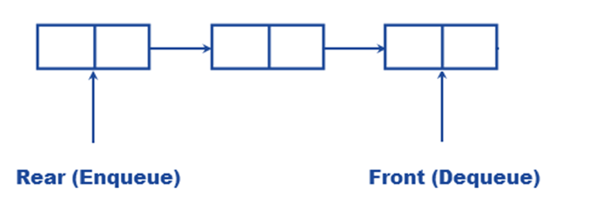
Types Of Queue
Simple Queue- It is the most basic queue in which the insertion of an item is done at the front of the queue and deletion takes place at the end of the queue.
Circular Queue- In a circular node, the last node is connected to the first node. It is also known as a Ring Buffer as all the ends are connected to another end. Insertion takes place at the front of the queue and deletion at the end of the queue.

Slide 5
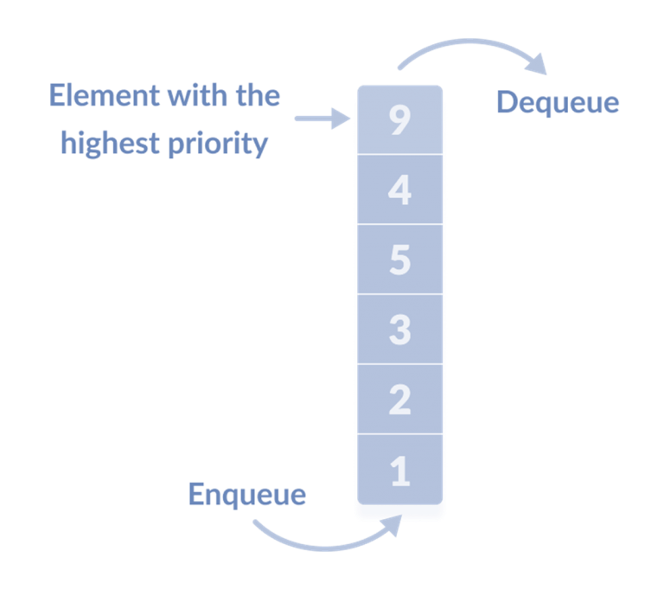
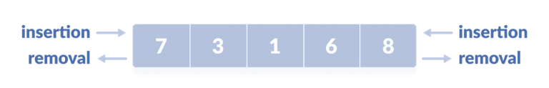
Types Of Queue
Priority Queue- In a priority queue, the nodes will have some predefined priority in the priority queue. The node with the least priority will be the first to be removed from the queue. Insertion takes place in the order of arrival of the nodes. The applications of priority queue include Dijkstra’s shortest path algorithm, prim’s algorithm, and data compression techniques like Huffman code.
Dequeue (Double Ended Queue)-In a double-ended queue, insertion and deletion can take place at both the front and rear ends of the queue.

Slide 6
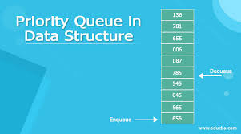
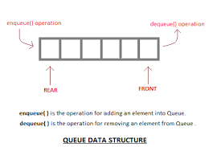
Operations On Queue
Enqueuer Operation:
Below are the steps to enqueue (insert) data into a queue:
Check whether the queue is full or not.
If the queue is full – print the overflow error and exit the program.
If the queue is not full – increment the rear pointer to point to the next empty space.
Add the element in the position pointed to by the Rear.
Return success.

Slide 7
Operations On Queue
Dequeue Operation:
Below are the steps to perform dequeue operation:
Check whether the queue is full or not.
If the queue is empty – print the underflow error and exit the program.
If the queue is not empty – access the data where the front is pointing.
Increment the front pointer to point to the next available data element.
Return success.

Slide 8
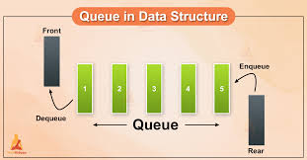
Implementation Of Queue
A queue can be implemented in two ways:
Sequential allocation: It can be implemented using an array. A queue implemented using an array can organize only a limited number of elements.
Linked list allocation: It can be implemented using a linked list. A queue implemented using a linked list can organize an unlimited number of elements.

Slide 9


